Slide 1

k
Point-of-sale fintech

Slide 2
The COMPANY
CredPal is a fintech company that develops point-of-sale credit infrastructure to ease consumer credit purchases
Enables retail businesses to provide on-demand credit for the consumer population.
CredPal is working from Lagos Nigeria.

Slide 3
THE TASK
Stripe, a software technology company based in San Francisco decided to invest 2.9million USD in CredPal.
Part of the journey is to;
Analyze consumers’ spending habits at different levels and regions
Validate the argument that users (from different countries) have a spending pattern and a capability to save.
Understand consumers’ saving capability
Demonstrate scalability of CredPal solution

Slide 4
The data
The data consist of 12 columns and 500,000 rows
Part of the columns are showing;
Region and countries of the consumers
Consumer preference: What consumers’ spend on
Number of samples:
Total income, Total expenditure and Disposable income
Disposable income: This is the difference between total income and total expenditure (saving capability Indicator).

Slide 5
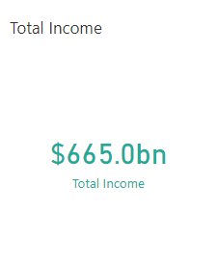
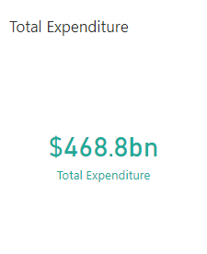
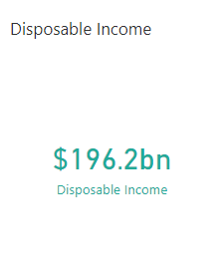
The insights

Slide 6
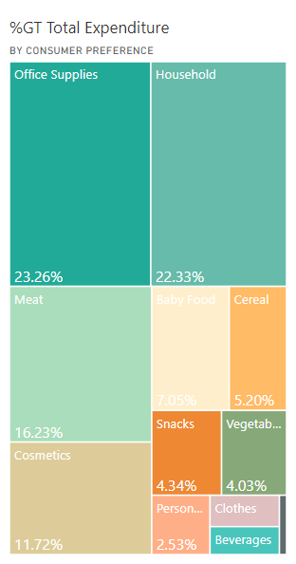
The insights
The spending pattern of consumers is the same across all regions.
Office supplies and household items top the list of things consumers spend on

Slide 7
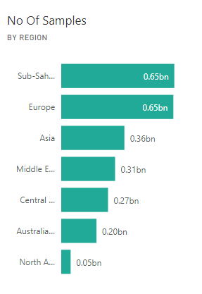
The insights
Sub Saharan Africa and Europe has the highest number on customer
It is not surprising that these regions will generate the highest income

Slide 8
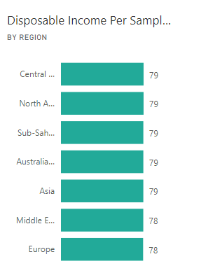
The insights
Consumers’ sample size will tilt the saving capacity per region
Disposable income per sample size was computed.
The consumers’ saving capacity is relatively the same across all regions.

Slide 9
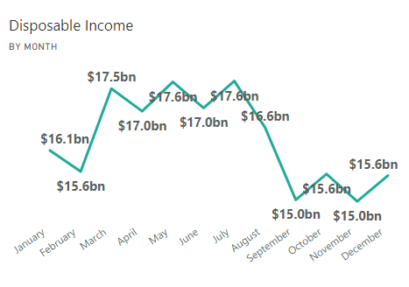
The insights
Open in Power BI credpal Data as of 12/25/21, 5:41 PM
Consumers’ saving capacity were the least at the beginning and the end of the year.
Consumers’ spend most Q4 and the first two months of the year.

Slide 10
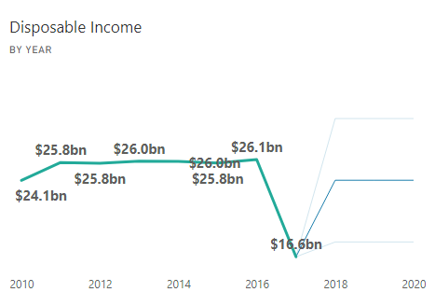
The insights
Open in Power BI credpal Data as of 12/25/21, 5:41 PM
Disposable income was projected three years ahead
The three fainted lines shows the highest, the mean and least disposable income.
The median line is close to the data from historical data.

Slide 11
Recommendations
Credpal can advice consumers’ on spending habit
Credpal should distil to other regions other than Africa and Europe
Get more consumers on board from these regions
Help consumers identify what the spend more on at the beginning and the end of the year.
The projected disposable income shows that consumers can pay back.

Slide 12
